Slide 1
Digital Portfolio
STUDENT NAME: PRADAKSHINA S.K
REGISTER NO AND NMID:
2426J1537/BC1DA7349607643BA8649490C19E6276
DEPARTMENT: B.SC INFORMATION TECHNOLOGY
COLLEGE: KPR COLLEGE OF ARTS SCIENCE AND RESEARCH
UNIVERSITY:BHARATHIYAR UNIVERSITY

Slide 2
PROJECT TITLE
PERSONAL WEBSITE PORTFOLIO FOR CAREER ENHANCEMENT

Slide 3


AGENDA
Problem Statement
Project Overview
End Users
Tools and Technologies
Portfolio design and Layout
Features and Functionality
Results and Screenshots
Conclusion
Github Link
3/21/2024 Annual Review

Slide 4

PROBLEM STATEMENT
Traditional resumes are static and lack interactivity.
Students need a modern way to showcase their skills, projects, and achievements.
A personal website portfolio provides a professional digital identity.

Slide 5

PROJECT OVERVIEW
The project focuses on creating a personal website.
It includes details like about me, skills, projects, achievements, and contact information.
Designed to be simple, attractive, and shareable.

Slide 6

WHO ARE THE END USERS?
Students – showcase skills and academic projects.
Recruiters/Companies – view candidate’s portfolio.
Educators/Mentors – track student growth.
General Audience – access creative works.

Slide 7

TOOLS AND TECHNIQUES
HTML, CSS, JavaScript – for coding the website.
GitHub Pages – for hosting (optional).
Canva/Google Sites/Wix – alternative no-code tools.

Slide 8
POTFOLIO DESIGN AND LAYOUT
Homepage – Name, photo, tagline.
About Me – Education, interests, goals.
Skills Section – Technical & creative skills.
Projects – Mini projects with descriptions/screenshots.
Achievements & Certificates – Proof of learning.
Contact – Email, LinkedIn, or form.
8

Slide 9
FEATURES AND FUNCTIONALITY
Simple responsive design.
Interactive navigation between sections.
Easy to update with new projects.
Lightweight & accessible on any device.

Slide 10
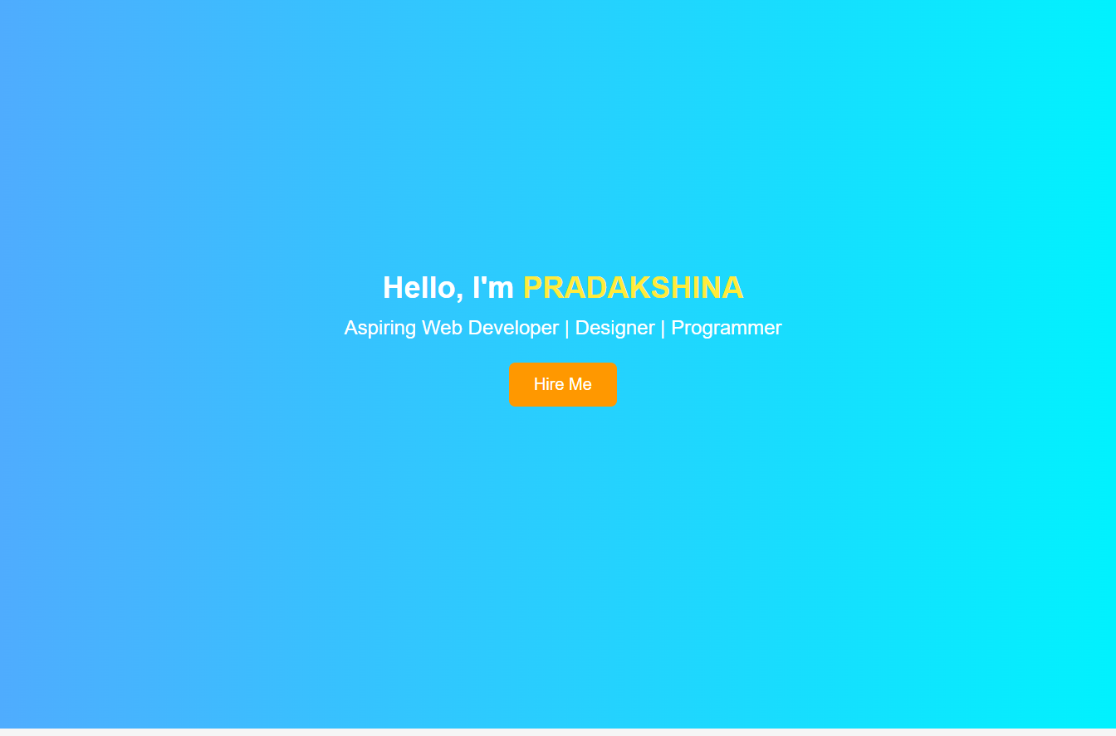

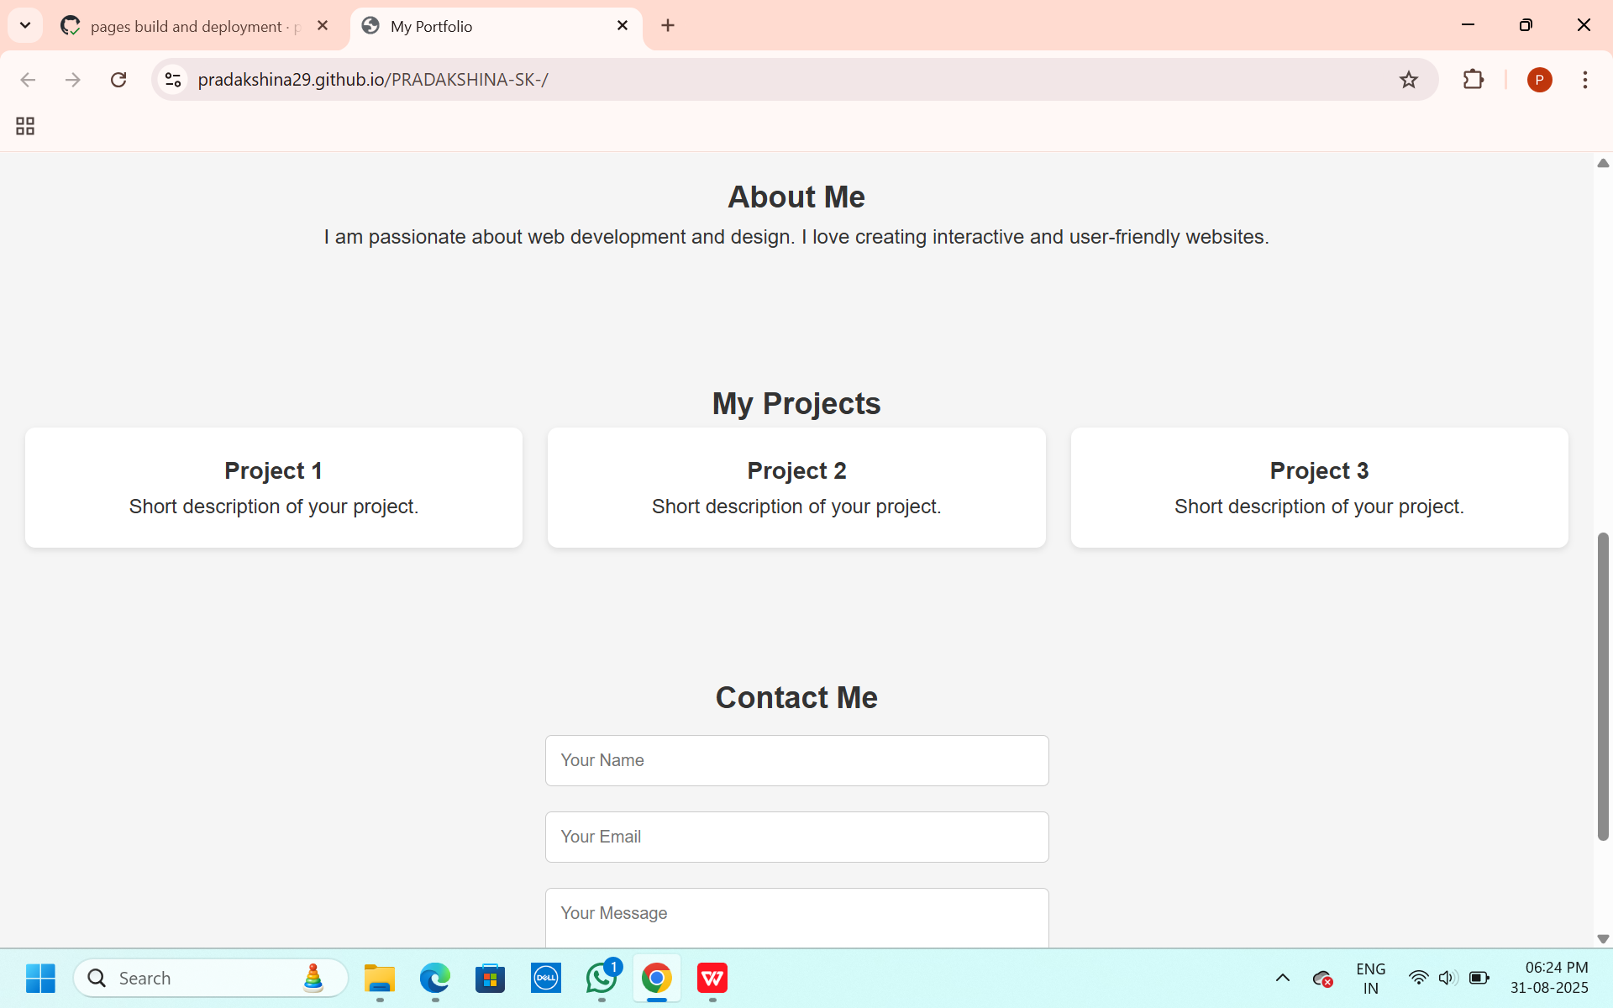
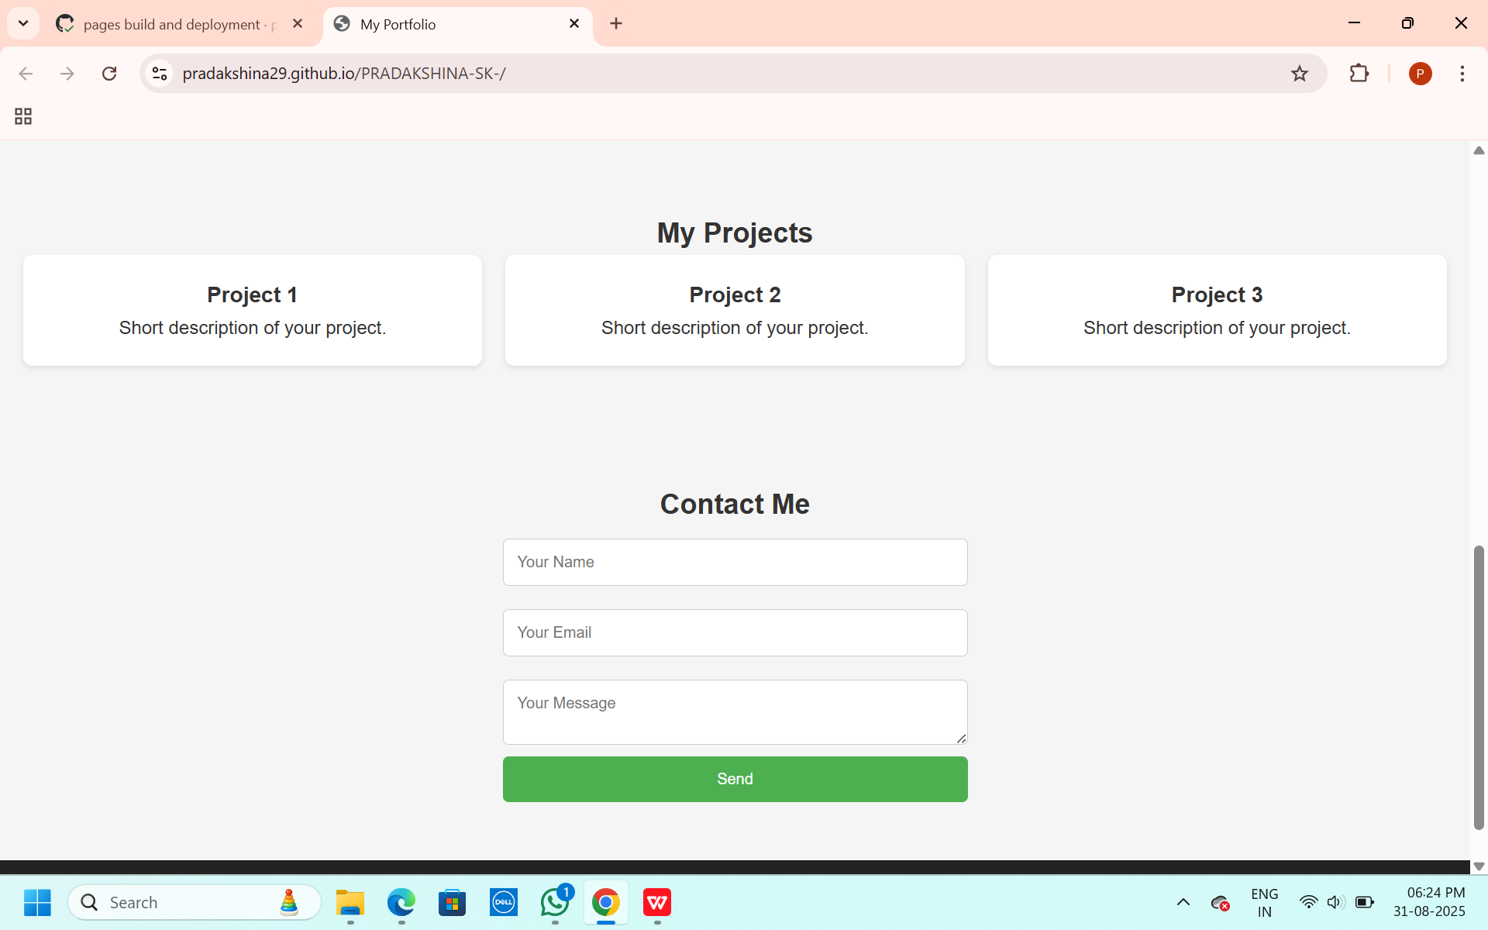
RESULTS AND SCREENSHOTS
The Personal Website Portfolio was successfully developed with a clean and attractive homepage showcasing the student’s name and tagline. The projects section displayed all mini projects along with descriptions and screenshots, making it easier for recruiters and mentors to assess the student’s work. The contact section provided email and LinkedIn links, enabling smooth communication. Overall, the portfolio worked well as a digital resume and could be accessed on any device.
3/21/2024 Annual Review
10

Slide 11
CONCLUSION
Created a Personal Website Portfolio as a digital resume.
Helps in showcasing skills, achievements, and projects.
Enhances career opportunities with a modern online presence.
11

